Slide 1
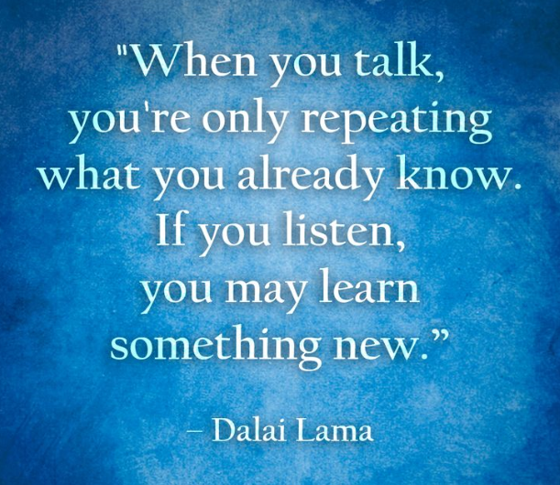

Slide 2
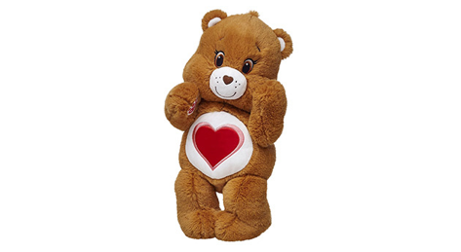
Notes:
Here are some characteristics and skills related to being a good listener:
Care – Listen like you care – give cues that you are really listening – eye contact, nodding, verbal responses all give people reassurance that what they are saying is important to you.
Ask relevant questions – seek to understand – if something is not clear to you, ask for clarification so you can continue to follow the conversation actively. Be cautious not to ask too many questions though, and only those that are helpful for understanding (e.g. more for understanding that to give advice or disagree with what is being said)
Balance your heart with your mind – listen intelligently to a person’s words and intuitively to their feelings about those words. You can question the meaning of what they are saying and what actions they have taken, but you can’t question whether they are right or wrong to feel the way they do – that is the way they feel.
Don’t judge – the fastest way to stop someone from sharing with you is to pass personal judgment on them based on what they are telling you. Even if someone is wanting feedback from you about something, while you are listening to her, keep your mind open and your body language neutral or even better, supportive; Empathy - this goes a long way to building trust.
Have empathy be sure to acknowledge and mirror emotions when you are listening to someone – imagine the difference of talking to someone about something great that just happened and having them respond with similar excitement or with a polite ‘that’s nice’ – or sharing a frustration and having them tell you ‘it’s no big deal’.
Know why someone is talking to you – clarify if they want you to listen to help them evaluate a situation, give advice, or just to share news or get something our of their head or off their chest. Then tailor your responses. In this case, don’t give advice or offer to evaluate unless they have asked you to or you have asked permissions.

Slide 3
Activity
Partner with one other person.
Determine who has the next birthday – you are ‘A’
B’s turn around so you can’t see the screen.

Slide 4
Activity
‘A’ – pretend you are listening, but be inattentive –
think about something else, listen to someone else,
look away, etc.

Slide 5
Activity
‘B’ – tell ‘A’ about something that happened to you
that evoked a strong emotion – fear, joy, excitement

Slide 6
Activity
‘B’ – listen intentionally this time; ‘A’ tell your story
again

Slide 7
Level 4
WHO WANTS TO BE AN
WHO WANTS TO BE AN
ADMINISTRATIVE
LEADER
What if the most effective way to influence
the behavior of other people?
Punish them severely if they don’t do what you want
Tell them how you want them to behave
Inspire them with your own conviction and actions
Ask someone else to tell them how to behave

Slide 8
Level 4
WHO WANTS TO BE AN
WHO WANTS TO BE AN
ADMINISTRATIVE
LEADER
What if the most effective way to influence
the behavior of other people?
Inspire them with your own conviction and actions

Slide 9
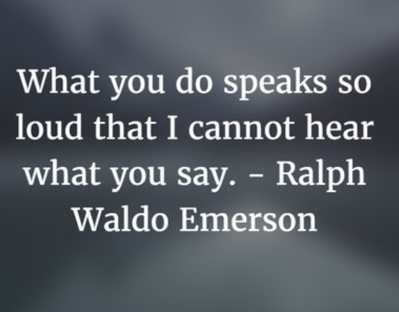

Slide 10
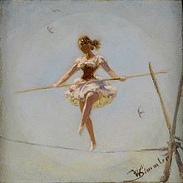
TAKE INITIATIVE
AND ACTION
WALK THE WALK
SHOW APPRECIATION FOR EFFORT
CAST AND LIVE
THE VISION
Notes:
How to inspire:
Walk the walk – you can’t expect others to behave in a way that you as a leader do or would not. It the section leader takes qualification lightly, guess how the rest of the section will feel!
Take Initiative and Action – Be bold! Working within your chorus’s agreed upon processes, offer new ideas and solutions along with how you are willing to move these ideas and solutions forward. Act on the strength of your conviction.
Cast and Live the Vision – Share the vision frequently and consistently. Stay true to the vision, especially when there are setbacks. Let it be your inspiration and share that inspiration with your chorus members.
Express Gratitude – Give people credit for what they do and thank them sincerely and specifically – let them know the difference they made. Find out how people like you to thank them; do they prefer a personal note or maybe a hug with gratitude. Along with some kind of personal appreciation, public acknowledgment is important when a group has benefited – e.g. thanking a chorus member for fulfilling their chorus roles with excellence - not just for the person receiving the gratitude but for those who have benefited. It helps set up a culture of gratitude.

Slide 11
Activity
Identify someone who has been an inspirational
leader to you and tell us why.

Slide 12
Level 5
WHO WANTS TO BE AN
WHO WANTS TO BE AN
ADMINISTRATIVE
LEADER
What is the most important thing that you, as an
administrative leader, can do for your chorus?
Ensure you are recognizing
and building future leaders
Help them win a regional championship
Maintain the chorus history book
Interview future chorus directors

Slide 13
Level 5
WHO WANTS TO BE AN
WHO WANTS TO BE AN
ADMINISTRATIVE
LEADER
What is the most important thing that you, as an
administrative leader, can do for your chorus?
Ensure you are recognizing
and building future leaders
Notes:
There are so many important things that you do for your chorus, and none of them are unimportant (or you wouldn’t be doing them). Most important though is to ensure that when you ‘move on’, the chorus continues to thrive. That means helping find your own replacement and build her skills so she can step into your shoes.

Slide 14
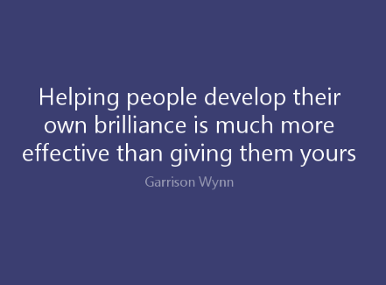

Slide 15
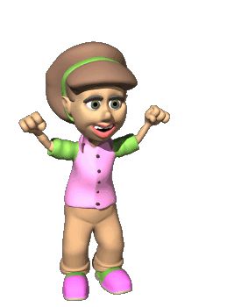
New leaders
developed!
Leadership
position!
Leadership delegation!
Success at
more challenging levels!
Celebrate
successes!
Express
gratitude!
Set up
for success!

Slide 16
Activity
Talk about your own leadership journey.
What were some important ‘steps’?

Slide 17
Level 6
WHO WANTS TO BE AN
WHO WANTS TO BE AN
ADMINISTRATIVE
LEADER
If you are a servant leader
it means:
Leading selflessly will always be easy for you
You have a lack of sense of
self
Your central focus remains on what is best for the group
You always give in to the
opinions of other

Slide 18
Level 6
WHO WANTS TO BE AN
WHO WANTS TO BE AN
ADMINISTRATIVE
LEADER
If you are a servant leader
it means:
Your central focus remains on what is best for the group
Notes:
Servant leadership is not about letting others always have their way, doing things for them, letting bad behavior go unchecked or allowing others to mistreat you. It is about the mindset of putting the benefit of the group above your own preferences or personal benefit; the success and achievement of the group ahead of your own success and achievement. Servant leadership is a natural outcome of the desire to serve; an aspiration to develop and use leadership skills because that is the best way YOU can serve. It is motivated and manifests differently than leadership that comes out of the desire to be a leader.
There are compromises and sacrifices to make as a servant leader, but it is very important to understand that servant leadership is NOT about working against your own values or beliefs; in fact to be an effective servant leader of a group, you must believe and align with its mission, vision and values. It is impossible to lead authentically if you don’t!

Slide 19
